Slide 1
Website Accessibility & the ADA
Megan J. Griffith
Senior Municipal Law Attorney
Kentucky League of Cities

Slide 2
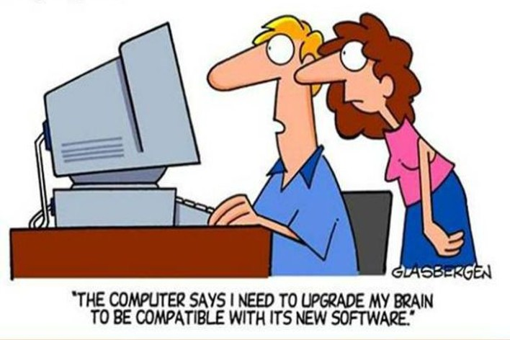

Slide 3

Americans with Disabilities Act
Federal civil rights law passed in 1990.
Prohibits discrimination based on disability.
Ensures equal access to Government services, public programs and public accommodations.
Divided into titles:
  Title I: Employment
  Title II: State and local government services
  Title III: Public accommodation (private businesses)

Slide 4
How ADA Applied to Online Content Before:
Before new rule, ADA did not explicitly mention websites (think 1990).
There has ALWAYS been a duty to make websites accessible BUT there was no uniform technical standard.
This resulted in:
  Patchwork of court rulings and DOJ enforcement actions
  Uncertainty for government agencies
  Inaccessible services for those with disabilities

Slide 5
The History
2010
DOJ issued an Advance Notice of Proposed Rulemaking, but rule was never finalized.
2017
DOJ officially withdrew the pending rulemaking.
2023
DOJ restarted the rulemaking process and issued a Notice of Proposed Rulemaking in 2023 focused, specifically on Title II.
2024
Final rule issued on April 24, 2024.

Slide 6

Title II Amendment
Requires compliance with Web Content Accessibility Guidelines (WCAG) 2.1, Level AA.
First binding national standard.
“Just as stairs can exclude people who use wheelchairs from accessing government buildings, inaccessible web content and mobile apps can exclude people with a range of disabilities from accessing government services.”

Slide 7
Compliance Deadlines
Size of Government Entity | Compliance Date
Population of 0 to 49,999 | April 26, 2027
Special District Governments | April 26, 2027
Population of 50,000 + | April 24, 2026

Slide 8
What is WCAG?
WCAG – Web Content Accessibility Guidelines
Created by W3C (World Wide Web Consortium) which is an international body that develops core technical standards for how the web works. (Ex: Browsers, search engines, software, etc.)
This is the technical framework that explains HOW to make web content accessible.

Slide 9
What happens if we don’t comply?
Private Action
  Some states authorize monetary damages (NY & FL).
  Serial litigants who are hoping for easy settlements.
DOJ Enforcement Action
  Up to $75,000 fine for first offense and $150,000 fine for subsequent offenses.

Slide 10
How Do We Implement WCAG?
Zack Looney
Front End Designer & Developer
Kentucky League of Cities

Slide 11
POUR
Perceivable:
  Provide alt-text for images / media
  Use strong color contrast
  Add captions to video / audio
  Make layouts adaptable

Slide 12
POUR
Operable:
  All functions work via keyboard
  Show clear focus indicators
  Limit flashing
  Use consistent navigation

Slide 13
POUR
Understandable:
  Use clear language
  Predictable page behavior
  Help users fix errors

Slide 14
POUR
Robust:
  Support assistive technology
  Use semantic, valid code
  Announce status changes properly

Slide 15
Common Financial Chart Problems
Color as the only means of conveying information
Insufficient contrast between data series
No keyboard access to interactive elements
Missing or inadequate alternative text

Slide 16
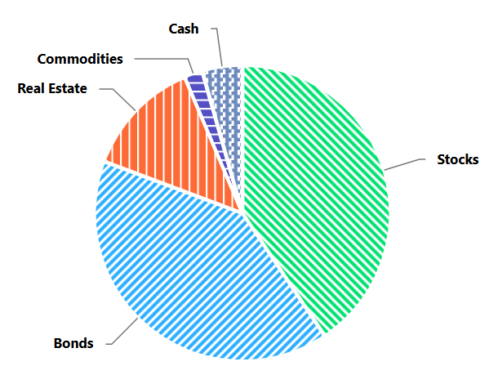
Solution 1: Color + Pattern/Texture
Never rely on color alone. Add visual patterns:
Use different line styles (solid, dashed, dotted)
Add patterns to bar fills (stripes, dots, hatching)
Use shapes for data points (circle, square, triangle)

Slide 17
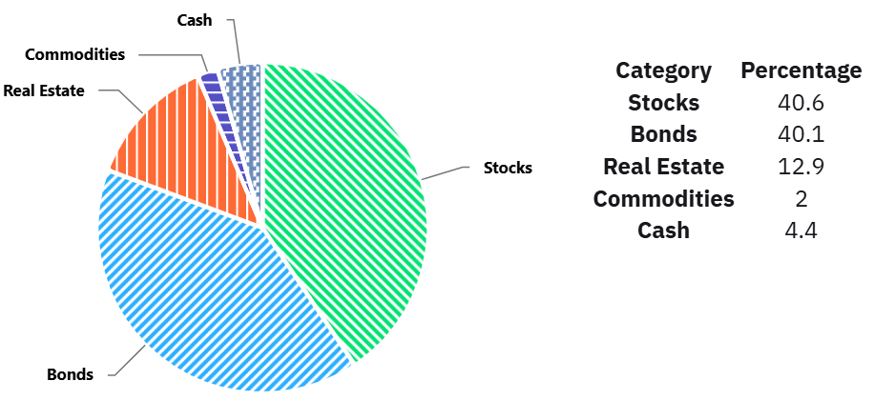
Solution 2: Provide Data Tables
Level AA Best Practice (not required)
Offer downloadable CSV or Excel files
Include accessible HTML data tables
Use proper table headers and scope attributes

Slide 18
Solution 3: Descriptive Alt Text
Bad:
"Pie chart of investments“
Good (Meets WCAG 2.1 AA):
"Pie chart showing investment portfolio allocation. Stocks comprise approximately 40.6%, followed by Bonds at 40.1%, Real Estate at 12.9%, Commodities at 2%, and Cash at 4.4%.”

Slide 19
Solution 4: Keyboard Access
For interactive data / charts
All interactive chart elements must work with Tab key
Provide visible focus indicators
Arrow keys for navigating data points
Enter/Space to activate controls

Slide 20
Accessible PDF Requirements
1. PDFs must be tagged with proper structure
PDFs need to include hidden "tags" that define the document structure (like HTML tags).
How to create: Use "Export to PDF" with accessibility options in Word/Excel, or use Adobe Acrobat's "Make Accessible" tool.
2. Charts / images in PDFs need alt text
3. Reading order must be logical
Why it matters: Screen readers follow the tagged order, not visual position. Wrong order = confusing, nonsensical content flow.
How to fix:
  In Adobe Acrobat: Use "Reading Order" tool to reorder content
  Test: Use Adobe's "Read Out Loud" feature to verify order

Slide 21

Limited Exceptions
Archived content
Preexisting conventional documents
Third party content
Individualized, password protected
Preexisting social media posts
“Minimal impact”

Slide 22
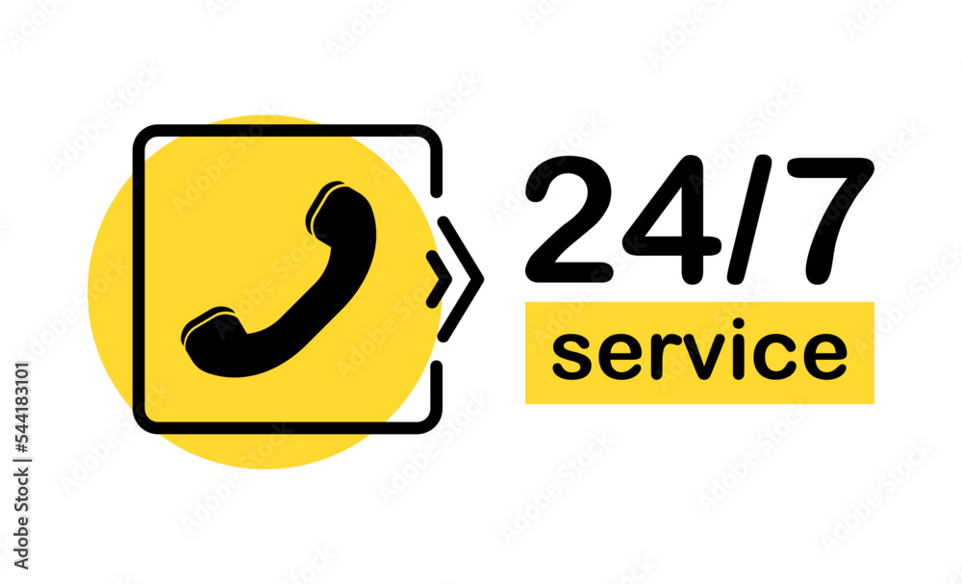
Alternative Methods?
ADA, Section 504
Digital content must be directly accessible and not just “accessible by alternative means.”

Slide 23


Training Resources
ada.gov/resources/small-entity-compliance-guide
mn.gov/mnit

Slide 24


Website Evaluation Tools
WAVE
webaim.org
w3.org/WAI/
test-evaluate/tools/list

Slide 25

Empowering
Accessibility:
The ADA Final
Rule and County
Finance

Slide 26

The Finance Office's Role in ADA Compliance
Beyond Legal Obligations: Integrating Accessibility into Financial Operations
Budgeting for
Accessibility
Procurement Policies
Training and
Awareness
Data Management
Incorporate accessibility
requirements into
purchasing decisions,
vendor contracts, and
RFPs.
Track compliance efforts,
key metrics, and risk
mitigation strategies.
Allocate resources for
compliance initiatives and
digital transformation
efforts.
Fund and support staff
education on digital
accessibility best
practices.

Slide 27




Implications for Financial Operations with a Digital Focus
Technology Investments
Vendor Management
Grant Management
Risk Mitigation
Adapting financial software
and systems for digital
accessibility.
Ensuring third-party digital
content and services meet
accessibility compliance.
Accessing and utilizing grants
specifically for accessibility
initiatives.
Proactive digital compliance
to avoid legal challenges and
financial liabilities.

Slide 28



County Best Practices in Digital Accessibility
Leveraging Governance, Policy, and Financial Planning
Sacramento County, CA
Montgomery County, MD
Washoe County, NV

Slide 29

Sacramento County, CA
Comprehensive Accessibility Policy
  Sacramento County adopts a standalone web accessibility policy aligned with WCAG 2.1 AA standards for ADA compliance.
Defined Scope and Responsibilities
  The policy clearly defines digital assets covered and assigns roles for oversight, implementation, and monitoring.
Transparency and Stakeholder Engagement
  Public-facing accessibility statement invites feedback and demonstrates commitment to transparency and inclusion.
Ongoing Monitoring and Compliance
  Regular audits and updates ensure evolving technology and standards are consistently met for sustainable accessibility.
Policy-Driven Accessibility Governance

Slide 30

Montgomery County, MD
Technical Standards & Procurement Integration
Integration of Accessibility Standards
  Montgomery County integrates WCAG 2.1 AA standards directly into procurement and IT governance.
Centralized IT Oversight
  Centralized IT oversight ensures accountability and consistency in accessibility compliance across digital platforms.
Risk Mitigation and Cost Reduction
  Embedding accessibility in procurement reduces remediation costs and mitigates legal and financial risks.
Sustainable Accessibility Practices
  Accessibility requirements embedded in procurement ensure ongoing compliance and evaluation of new technologies.

Slide 31

Washoe County, NV
Operationalizing Accessibility Through Training
Mandatory Staff Training
  Washoe County requires all relevant staff to complete mandatory training on digital accessibility and best practices.
Accessible Document Guidelines
  The county provides clear guidelines to help staff create accessible PDFs, Office documents, and web content.
Continuous Monitoring and Audits
  Regular audits and feedback loops identify and fix accessibility barriers to maintain compliance and quality.
Alignment with Business Priorities
  This approach supports internal controls, reduces remediation backlog, and strengthens audit defensibility in finance.

Slide 32




Key Elements for "GFOA Aligned" Digital ADA Programs
Connecting Digital Accessibility to Sound Public Finance Governance
Foundational Pillars for Digital ADA Compliance
Formal Policy
Adoption
Governance
Structure
Multi-Year
Remediation Plan
Procurement
Controls
Ongoing
Monitoring &
Training
Board-adopted
policy specifying
WCAG standards
(e.g., 2.1 AA) for
websites,
documents, apps,
and procurement.
Designated ADA
Coordinator, IT
involvement,
content liaisons,
and a formal
grievance process.
Website audits,
prioritized phased
remediation
aligned with IT
capital plans, and
budget allocation.
Accessibility
clauses in RFPs,
vendor VPAT
requirements, and
pre-launch
accessibility
testing.
Annual audits, staff
training, automated
scanning tools, and
transparent public
reporting.

Slide 33
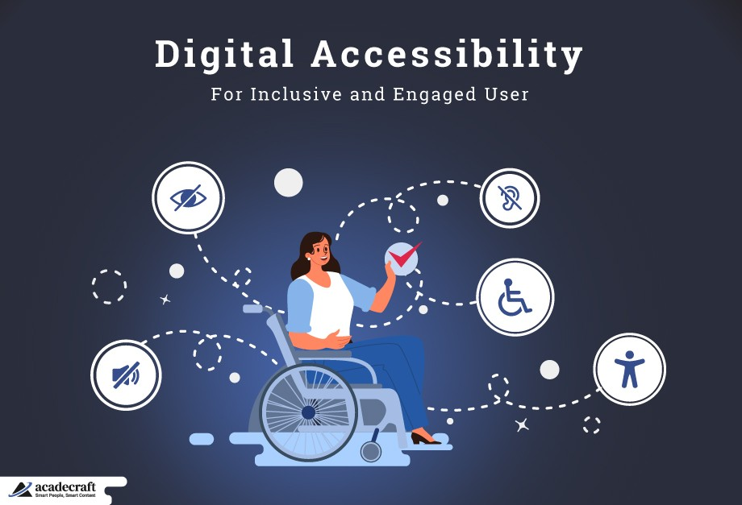
Building a Culture of Accessibility
Dedicated Responsibility
  Assign a core team or point person to champion and oversee digital accessibility initiatives.
Clear Policies & Procedures
  Develop comprehensive guidelines for content creation, design, development, and procurement to ensure accessibility standards.
Regular Audits & Assessments
  Systematically audit digital assets to identify and proactively remediate accessibility barriers and compliance gaps.
Continuous Training & Education
  Implement ongoing training programs to empower teams with the knowledge to create and maintain accessible digital experiences.

Slide 34

Key Takeaways for Finance Offices
Embracing Digital Accessibility as a Governance and Financial Management Imperative
Understand the Rule
  Grasp the fundamental changes, especially regarding digital presence and WCAG 2.1 AA standards.
Integrate Compliance
  Embed accessibility into financial planning, procurement, and IT capital plans.
Leverage Resources
  Utilize support systems like NACo and GFOA principles.
Champion Accessibility
  Lead by example in fostering an inclusive digital environment through sound governance.
Digital accessibility is a critical component of good governance and effective financial management.

